Slide 1
Musical Genre Recognition:
Traditional Methods vs. Deep Learning
Course: DT2470
Project Group 4:
Serkan Arda Yilal
Oliwer Ferm

Slide 2
Presentation Overview
1- Information About Dataset
2- Feature Extraction with Traditional Methods
3- Feature Extraction with Deep Learning
4- Remaining Problems and Tasks

Slide 3
Information About Dataset
https://github.com/mdeff/fma
In this project, we have used Free Music Archive (FMA) which is provided as small/medium/large version of it. The database has advantages such as:
Large scale (25.000 tracks, 16 genres, 44100Hz): avoids overtraining
Available audio: Not dependent only on the features provided as in some databases. Can be used in end-to-end training systems like DL.
High quality audio: no disturbance of noise
Proper audio extraction: 30 seconds excerpts are extracted from middle of tracks

Slide 4
Information About Dataset
Due to imbalance of # of tracks between different genres, we have chosen 500 tracks from 8 following genres:
Hip-Hop: 43 unique artists, 95 albums
Pop: 140 unique artists, 131 albums
Rock: 109 unique artists, 131 albums
Folk: 77 unique artists, 104 albums
Experimental: 206 unique artists, 179 albums
Electronic: 96 unique artists, 115 albums
Classical: 83 unique artists, 114 albums
Old-Time / Historic: 337 unique artists, 101 albums

Slide 5
Information About Dataset
Before we partition the data to 60/20/20 for training/validation/test datasets, we ordered each genre with artist name. Number of common artists are given as:
Hip-Hop: intersect(train, validation) = 1 ,intersect(train, test) = 0
Pop: intersect(train, validation) = 1 ,intersect(train, test) = 0
Rock: intersect(train, validation) = 1 ,intersect(train, test) = 0
Folk: intersect(train, validation) = 1 ,intersect(train, test) = 0
Experimental: intersect(train, validation) = 1 ,intersect(train, test) = 0
Electronic: intersect(train, validation) = 1 ,intersect(train, test) = 0
Classical: intersect(train, validation) = 1 ,intersect(train, test) = 0
Old-Time / Historic: intersect(train, validation) = 0 ,intersect(train, test) = 0

Slide 6
Feature extraction with traditional methods
Goal: Extract features for potential usage in Bayesian or KNN classifier
Extracted features
Spectral centroids
Spectral bandwidth
Spectral flatness
Spectral rolloff
Zero crossing rate
Using the librosa.feature library: Feature extraction — librosa 0.6.0 documentation (hubwiz.com)

Slide 7
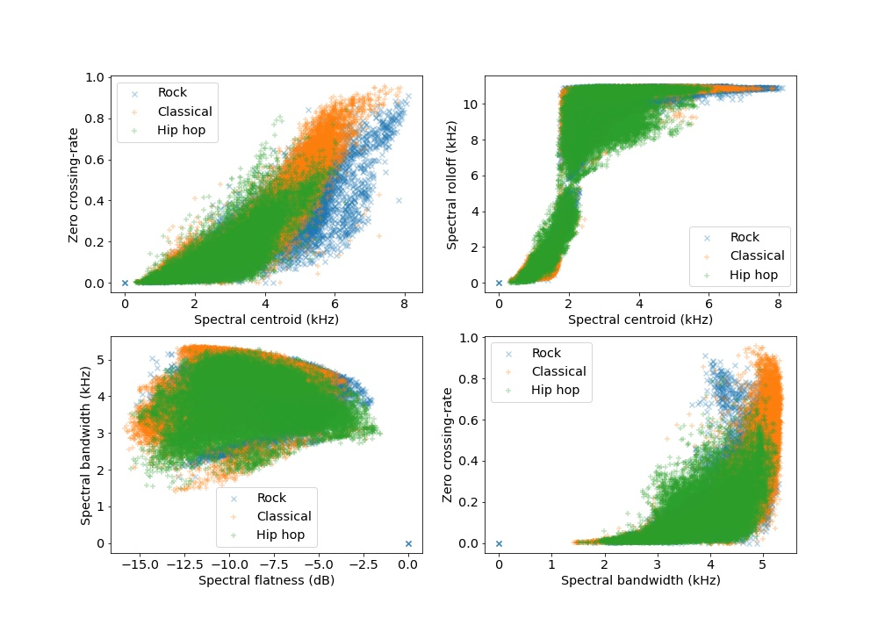
Feature Comparison
3 genres: Rock, Classical, Hip-Hop
50 tracks from each genre
STFT parameters
Window size: 100ms
Hop size: 100ms

Slide 8
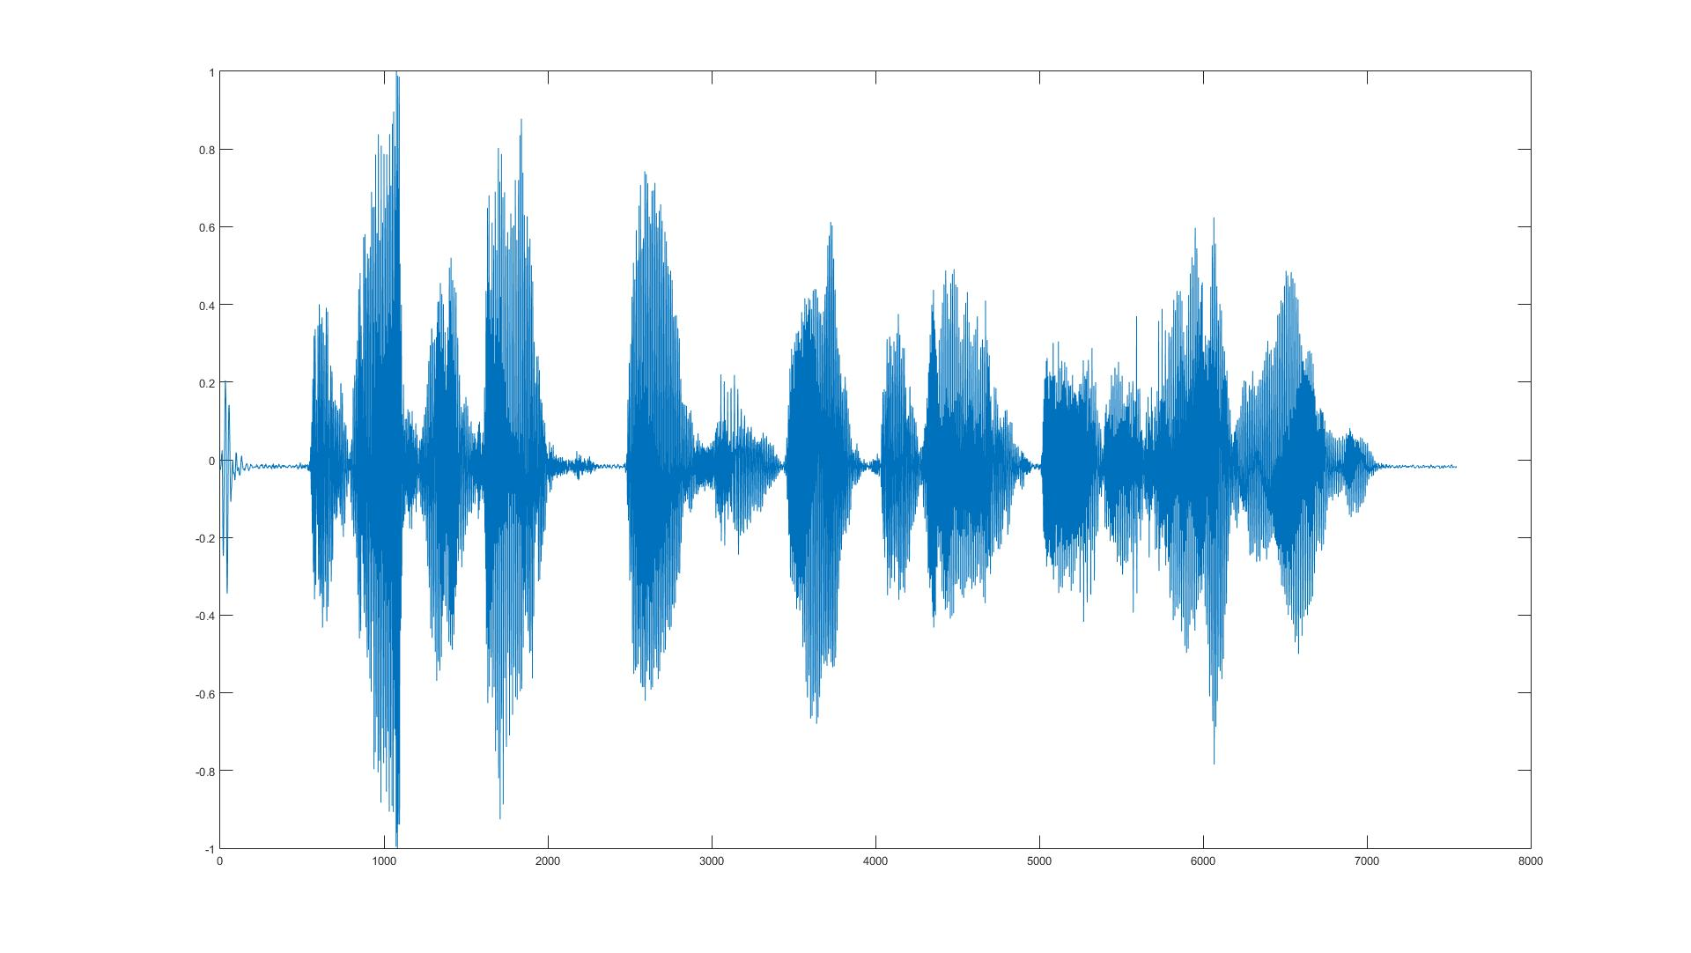
Feature Extraction with Deep Learning
Learning Features from usic audio with deep belief networks (Philippe Hamel and Douglas Eck): https://ismir2010.ismir.net/proceedings/ismir2010-58.pdf
Improved music feature learning with deep neural networks(Siddharth Sigtia and Simon Dixon):
https://ieeexplore.ieee.org/document/6854949
…
Input Layer
Hidden Layer 1 (50 Nodes)
...
ReLu Act.
Function
Hidden Layer 2 (50 Nodes)
...
...
Window Size: 46ms
Hop Size: 26 ms
Hidden Layer 3 (50 Nodes)
STFT
Output Layer 8 genres
Softmax Scores
Frames of 513 feature dimensions.
Feature Normalization (mean = 0, var = 1)
Input
Learning Rate = 0.01
Dropout Rate = 0.25

Slide 9
Remaining Problems and Tasks
Problems and Doubts:
In traditional part, features that are better at differentiating the genres are needed.
300 tracks per genre may take so much time to train in a deep network.
Using features provided in dataset or calculating them by hand?
Should classifiers be the same for both approaches?
Tasks:
Training with better features and get accuracy on test data for traditional method.
Training deep neural networks with proper amount of tracks
Create Confusion Matrices for each approach to compare the results

Slide 10
Thanks for Listening!

